Slide 1
Cellular & Mobile Communication
Prepared By: Er. Amit Kr. Tewari
Associate Professor
CS Dept.
ACEIT, Jaipur

Slide 2
Cellular Telephone Systems
A cellular radio system provides standard telephone service by two-way radio at remote locations. Cellular radios or telephones were originally installed in cars or trucks, but today most are handheld models.
Cellular telephones permit users to link up with the standard telephone system, which permits calls to any part of the world

Slide 3
Cellular Telephone Systems
The Bell Telephone Company division of AT&T developed the cellular radio system during the 1970s and fully implemented it during the early 1980s.
The original U.S. cell phone system, known as the advanced mobile phone system, or AMPS, was based on analog FM radio technologies.
AMPS has gradually been phased out and replaced by second-generation (2G), third-generation (3G), and fourth-generation (4G) digital cell phone systems. This section provides an overview of this awesome worldwide network.

Slide 4
Cellular Concepts
The basic concept behind the cellular radio system is that rather than serving a given geographic area with a single transmitter and receiver, the system divides the service area into many smaller areas known as cells.
The typical cell covers only several square miles and contains its own receiver and low-power transmitter. The coverage of a cell depends upon the density (number) of users in a given area.

Slide 5
Cellular Concepts (Contd…)
For a heavily populated city, many small cells are used to ensure service.
In less populated rural areas, fewer cells are used. Short cell antenna towers limit the cell coverage area. Higher towers give broader coverage.
The cell site is designed to reliably serve only persons and vehicles in its small cell area.

Slide 6
Cellular Concepts (Contd…)
Each cell is connected by telephone lines or a microwave radio relay link to a master control center known as the mobile telephone switching office (MTSO).
The MTSO controls all the cells and provides the interface between each cell and the main telephone office.
As the person with the cell phone passes through a cell, it is served by the cell transceiver.
The telephone call is routed through the MTSO and to the standard telephone system. As the person moves, the system automatically switches from one cell to the next

Slide 7
Cellular Concepts (Contd…) Hand-Off
The receiver in each cell station continuously monitors the signal strength of the mobile unit.
When the signal strength drops below a desired level, it automatically seeks a cell where the signal from the mobile unit is stronger.
The computer at the MTSO causes the transmission from the person to be switched from the weaker cell to the stronger cell. This is called a handoff.
All this takes place in a very short time and is completely unnoticeable to the user. The result is that optimum transmission and reception are obtained.

Slide 8
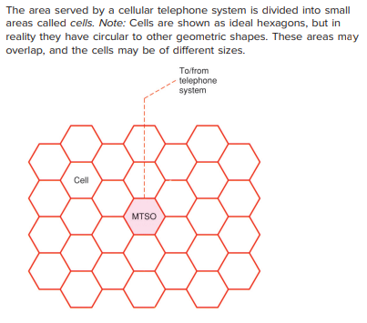

Slide 9
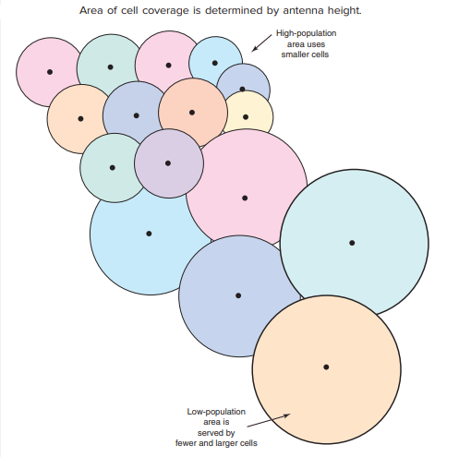

Slide 10
Frequency Allocation
Cellular radio systems operate in the UHF and microwave bands as assigned by the Federal Communications Commission (FCC).
The original frequency assignments were in the 800- to 900-MHz range previously occupied by the mostly unused UHF TV channels 68 through 83.

Slide 11
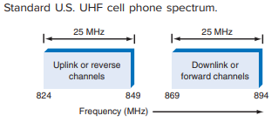
Frequency Allocation (Contd…)

Slide 12
Frequency Allocation (Contd…)
The frequencies between 824 and 849 MHz are reserved for the uplink transmissions from the cell phone to the base station.
These are also called the reverse channels. The frequencies between 869 and 894 MHz are the downlink bands from base station to cell phone.
Both of these 25-MHz segments of spectrum were originally divided into 832 channels 30 kHz wide.
While these are still used, the different cell phone technologies use different amounts of bandwidth, such as 30 kHz, 200 kHz, and 1.25 MHz, so this spectrum gets used in different ways by different cell phone companies in different locations.

Slide 13
Major Issue in Frequency Allocation
One of the major issues in the cell phone business lies in obtaining more spectrum for more subscribers.
More subscribers mean greater income. Yet, spectrum is scarce and very expensive.
More recently, there is available space in the 1700- to 1750-MHz range.
Some spectrum is also available in the 1900- to 2300-MHz and 2500- to 2700-MHz range for newer 4G systems.
Also keep in mind that different countries use different spectrum blocks.

Slide 14
Frequency Reuse
In frequency reuse, individual frequency bands are shared by multiple base stations and users.
This is possible by ensuring that one subscriber or base station does not interfere with any others.
This is achieved by controlling such factors as transmission power, base station spacing, and antenna height and radiation patterns.

Slide 15
Frequency Reuse using 7 frequencies allocations
f2
f7
f3
f2
f1
f7
f3
f6
f4
f1
f2
f5
f6
f4
f7
f3
f2
f5
f1
f7
f3
f2
f6
f4
f1
f7
f3
f5
f6
f4
f1
f5
f6
f4
f5
Each cell is generally 4 to 8 miles in diameter with a lower limit
around 2 miles.

Slide 16
Multiple Access
Multiple access refers to how the subscribers are allocated to the assigned frequency spectrum.
Access methods are the ways in which many users share a limited amount of spectrum.
These techniques include
Frequency-Division Multiple Access (FDMA)
Time-Division Multiple Access (TDMA)
Code-Division Multiple Access (CDMA)
Spatial-Division Multiple Access (SDMA)

Slide 17
Frequency-Division Multiple Access (FDMA)
FDMA systems are like frequency- division multiplexing in that they allow many users to share a block of spectrum by simply dividing it up into many smaller channels.
One subscriber is assigned to each channel. Typical channel widths are 30 kHz, 200 kHz, 1.25 MHz, and 5 MHz. There are usually two similar bands, one for uplink and the other for downlink.

Slide 18
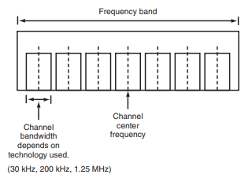
Frequency-division multiple-access (FDMA) spectrum

Slide 19
Time-Division Multiple Access
TDMA relies on digital signals and operates on a single channel.
Multiple users use different time slots. Because the audio signal is sampled at a rapid rate, the data words can be interleaved into different time slots.
Of the two common TDMA systems in use, one allows three users per frequency channel and the other allows eight users per channel.

Slide 20
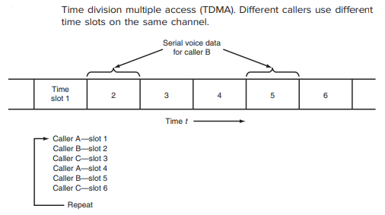
Time-Division Multiple Access

Slide 21
Code-Division Multiple Access
CDMA is just another name for spread spectrum. A high percentage of cell phone systems use direct sequence spread spectrum (DSSS).
Here the digital audio signals are encoded in a circuit called a vocoder to produce a 13-kbps serial digital compressed voice signal.
It is then combined with a higher-frequency chipping signal. One system uses a 1.288-Mbps chipping signal to encode the audio, spreading the signal over a 1.25-MHz channel.
With unique coding, up to 64 subscribers can share a 1.25-MHz channel

Slide 22
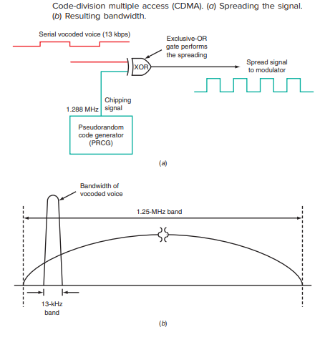

Slide 23
Wide CDMA
A similar technique is used with the wideband CDMA system of third-generation cellphones.
A 3.84-Mbps chipping rate is used in a 5-MHz channel to accommodate multiple users.

